Slide 1
BCOG 100
Language
Lecture 1: Genus Homo
and the Evolution of Langauge

Slide 2
Reading Check 11-1
Password: kanzi
Question: According to the reading, what is language?
Notes:
Last time we examined earlier stages in evolution
and asked what new adaptive problems were created
as mammals changed their ecological strategies. This week we apply the same lens to the evolution of social cognition in primates
— not by starting with mechanisms, but by first identifying what needs to be explained.
Today we operate at the computational/functional level in Marr’s sense
— characterizing the problem that the lineage had to solve and the stable behavioral patterns that resulted. In Lecture 2 we will shift to the algorithmic level,
asking what kinds of representation and inference could, in principle, generate those patterns. In Lecture 3 we move to the implementational level,
asking how primate brains might instantiate those algorithms in actual circuits.
By the end of today, the explanandum will be defined. Only then do we try to explain how it could work.

Slide 3
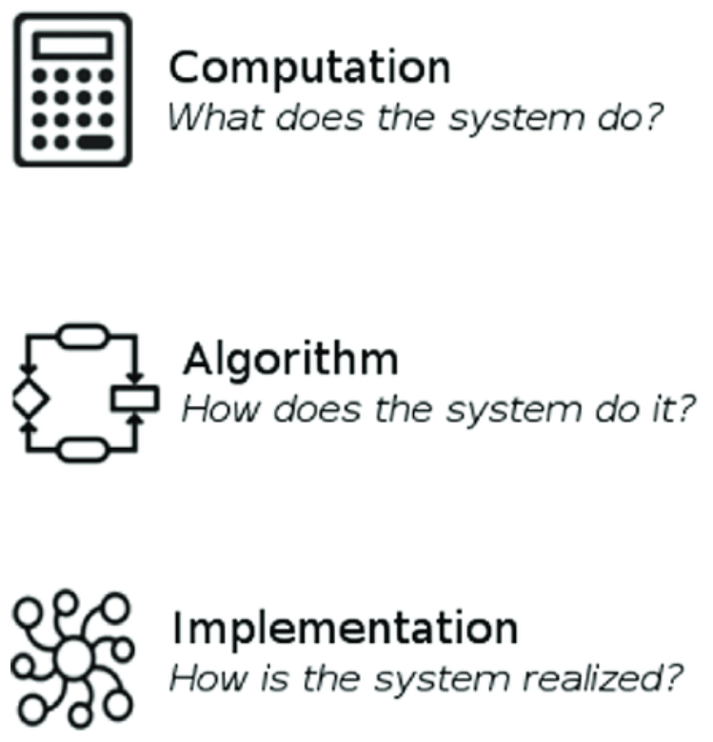
The Evolution of Homo Sapiens and Language
Recap & Overview
Last Time:
Social cognition and theory of mind in primates
Today:
This week: evolution of language and modern human minds
Notes:
Last week we explored how primate brains evolved to understand
one another’s thoughts, goals, and emotions, allowing cooperation and competition in complex social groups.
These abilities—what we called theory of mind
—gave primates the power to predict behavior, form alliances, and navigate social hierarchies.
They were the cognitive foundation for everything that followed.
This week we move forward in evolutionary time, from social primates to the first humans.
We’ll ask what changed in the structure and function of the brain
that made our species capable of culture, art, and cumulative knowledge.
In particular, we’ll look at how a new form of communication—language
—transformed how minds could share and build on one another’s ideas.
Across these three lectures, we’ll study language through Marr’s three levels of analysis.
Today we’ll treat it functionally, as an evolutionary adaptation that solved new problems of cooperation and learning.
Next time we’ll look at competing theories of how language actually works in the mind.
And finally, we’ll explore how the brain implements it, and how those neural systems evolved.

Slide 4
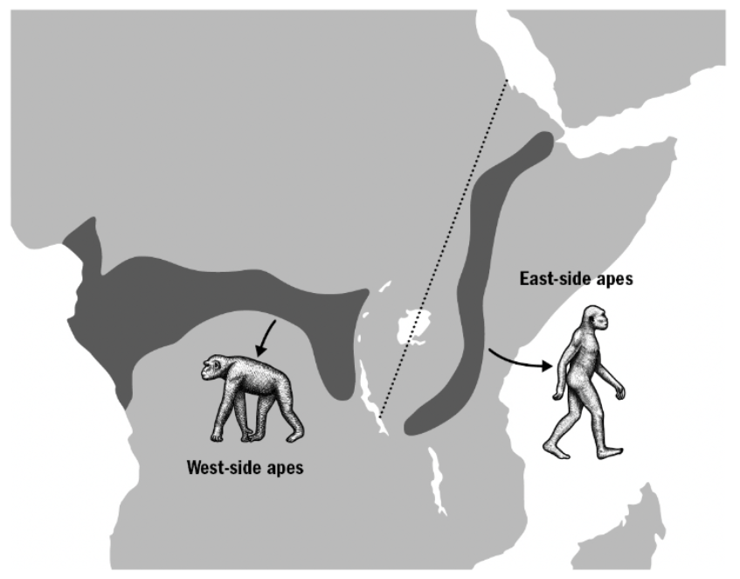
The Evolution of Homo Sapiens and Language
From Apes to Early Homo
Divergence from chimpanzees about seven million years ago
Changing climate reshaped African ecosystems
Early hominins adapted to new environments
Notes:
Around seven million years ago, our ancestors diverged from the common ancestor we share with chimpanzees.
At that time, Africa’s environment was beginning to change
—dense forests giving way to patchy woodlands and open grasslands.
These shifts in climate and habitat created new challenges for food, safety, and mobility.
Early hominins such as Australopithecus evolved traits that fit this new world.
They became bipedal, freeing their hands for carrying and tool use.
They learned to forage in open areas, facing new predators and temperature extremes.
Although these species were still small-brained compared to us,
they were already living in more flexible, opportunistic ways than their ape relatives.
This transition from forest to savannah would set the stage for the next major leap
—brains that could plan, cooperate, and learn in increasingly complex environments.

Slide 5
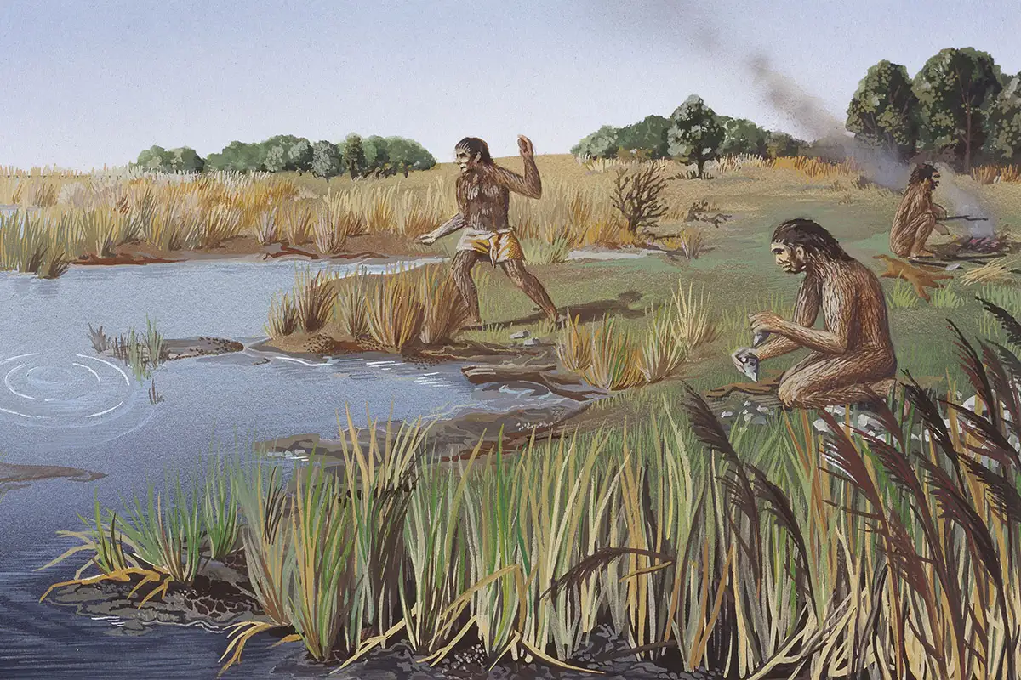
The Evolution of Homo Sapiens and Language
The Savannah Brain: Homo erectus and New Adaptations?
Homo erectus emerged about two million years ago
Larger brains and bodies, new tools and behaviors
Life on the savannah demanded coordination and learning
Notes:
Around two million years ago, a new kind of human appeared—Homo erectus.
They were taller, stronger, and far more wide-ranging than earlier hominins, spreading from Africa into Asia.
Their larger brains, about twice the size of Australopithecus, supported new kinds of planning and flexibility.
Archaeological evidence shows Homo erectus used fire, made refined stone tools,
and relied heavily on meat from hunting and scavenging.
They may have developed pair bonds and cooperative child rearing to raise their slow-developing offspring.
Longer childhoods created more time for learning, imitation, and social teaching.
Life on the open savannah was dangerous and complex.
To survive, Homo erectus groups had to share knowledge, coordinate hunts,
and pass down survival skills across generations.
These pressures began selecting for richer forms of communication and social learning
—the groundwork for language itself.

Slide 6
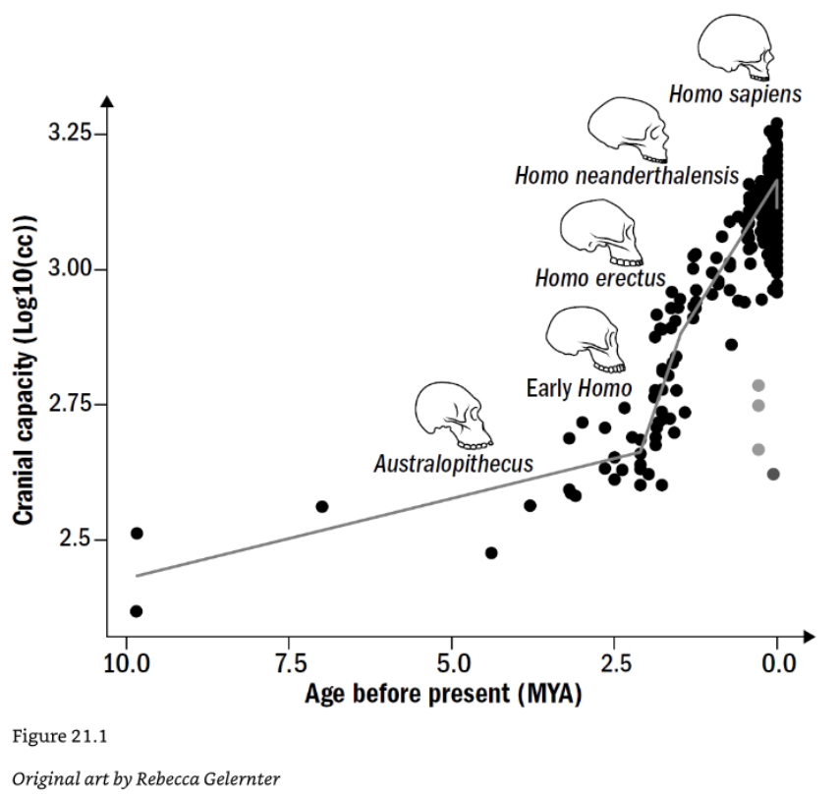
The Evolution of Homo Sapiens and Language
So What Changed in the Mind?
Early humans looked familiar but thought differently
Brains grew, but new kinds of thinking mattered more
Two key innovations: language and symbolic thought
Notes:
By the time of Homo erectus, the human body was already remarkably modern
—upright posture, strong hands, endurance running, and tool use.
But if you could look inside their minds, you would see something in transition.
They were beginning to solve problems in flexible ways, to cooperate with others,
and to pass knowledge from one generation to the next.
The most important changes were cognitive, not anatomical.
Brain size nearly doubled between Australopithecus and Homo erectus, but raw brainpower was not enough.
A bigger brain is costly—it requires more calories, longer childhoods, and slower reproduction.
So this expansion must have brought new capabilities that paid for themselves in survival and social success.
Those capabilities seem to involve planning, teaching, and understanding what others know or intend.
At this point, natural selection began favoring minds that could imagine events that hadn’t yet happened,
and communicate those ideas to others.
Being able to share strategies, warn of danger,
or teach toolmaking became as valuable as physical strength or speed.
Learning could now happen socially and mentally, not just through trial and error.
This shift transformed intelligence from an individual trait into a shared group resource.
The two adaptations that made this possible were language and symbolic thought.
Language let people express and transmit ideas with precision,
turning inner thoughts into shared representations.
Symbolic thought allowed those ideas to become abstract
—about time, number, causation, and moral rules.
Together they marked the beginning of the modern human mind:
a brain built not just to survive, but to communicate, imagine, and create culture.

Slide 7
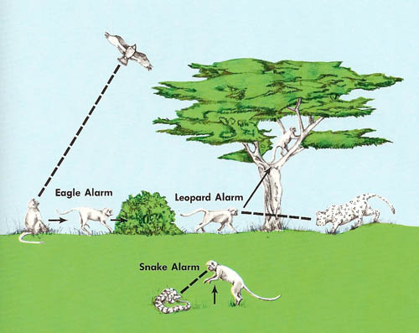
The Evolution of Homo Sapiens and Language
Communication Before Language
Communication evolved long before humans
Each lineage added new ways to share information
Language built on this deep evolutionary foundation
Notes:
Communication has existed since the dawn of multicellular life.
Our earliest ancestors, including the common ancestor we share with fish,
already relied on chemical and electrical signals to coordinate behavior.
These primitive systems let organisms broadcast information about danger, reproduction, or territory
—fast and automatic but inflexible.
Fish still use these channels today, flashing colors or emitting electric pulses
that convey emotional states and intentions.
With the rise of mammals, communication expanded beyond reflexive signaling.
Mammals developed rich vocal repertoires and facial expressions linked to emotional states.
They could growl, whimper, or purr to express fear, need, or contentment,
and use scent and posture to regulate social hierarchies.
This was the birth of affective communication—signals tied closely to feeling,
mediated by limbic systems like the amygdala.
Among primates, communication became increasingly social and intentional.
Monkeys began using specific calls for different predators, gestures for play or grooming,
and facial expressions to negotiate alliances.
These signals were learned and context-sensitive, reflecting the complexity of group life.
Communication was now a tool for managing relationships, not just expressing emotion.
Great apes extended this trend even further.
They use eye contact, gestures, and nuanced vocalizations to share goals,
request actions, and influence others’ behavior.
Some apes even combine gestures in flexible sequences or repurpose them to fit new situations.
Yet their signals remain grounded in emotion and immediacy
—they express intent but not abstract ideas.
This was the evolutionary platform on which human language would later emerge:
a communication system already powerful, social, and purposeful,
waiting for symbols and syntax to push it beyond the present moment.

Slide 8
The Evolution of Homo Sapiens and Language
How Is Human Language Different? Hockett’s Design Features
Feature | Brief Definition | Unique to Humans
Vocal-Auditory Channel | Language is typically spoken and heard.
Broadcast Transmission & Directional Reception | Speech radiates in all directions but can be localized.
Rapid Fading (Transitoriness) | Spoken signals fade quickly after being produced.
Interchangeability | Speakers can both send and receive the same messages.
Total Feedback | Speakers can hear and monitor their own speech.
Specialization | Sounds are produced solely for communication.
Semanticity | Specific signals have specific meanings.
Arbitrariness | No natural link between form and meaning.
Discreteness | Language uses distinct, separable units.
Displacement | Ability to refer to things not present in time or space. | X
Productivity (Open-Endedness) | Ability to create and understand novel messages. | X
Traditional (Cultural) Transmission | Language is learned socially, not genetically fixed. | X
Duality of Patterning | Meaningless units combine into meaningful ones. | X
Prevarication | Ability to lie or produce false statements. | X
Reflexiveness | Ability to use language to talk about language. | X
Learnability | Speakers of one language can learn another. | X
Notes:
Compared to even the most social apes, humans communicate on a different scale.
We use thousands of distinct words, invent new ones constantly,
and can express anything from a grocery list to a philosophical argument.
We can talk about the past and future, about things that don’t exist, and about ideas that can’t be seen.
Our communication can be playful, deceptive, creative, and endlessly recursive.
One influential attempt to catalog what makes human language distinctive
comes from linguist Charles Hockett, who listed a set of “design features” that together define it.
Some of these, like vocal communication and semantic meaning, are shared with other species.
Others—such as displacement, productivity, duality of patterning, and reflexiveness—appear unique to humans.
Hockett’s list isn’t the final word, but it remains a useful framework
for thinking about which ingredients separate language from simpler forms of communication.
Still, the question of why these features exist—and which matter most—remains open.
Some researchers emphasize structure: the hierarchical grammar
that allows us to combine words into complex meanings.
Others point to intentionality, the shared understanding that words are meant
to reveal what one person is thinking to another.
Still others focus on cultural learning, noting that language depends
on transmission and teaching across generations.
A growing number of scientists see language not as a single invention,
but as a mosaic of older skills that came together in humans.
From mammals we inherited emotional vocalization;
from primates, gestural control and social awareness;
from apes, imitation and turn-taking.
Language may have arisen when these pieces were integrated by a larger, more plastic brain
that could generalize and abstract across them.
In this view, language didn’t appear out of nowhere
—it was an emergent property of an already communicative mind.
The result is a system that seems both continuous and discontinuous with what came before.
It builds on ancient foundations, yet allows new forms of imagination, cooperation, and cumulative culture
that no other species has achieved.
Language may not be the only way to share information,
but it transformed how information could be represented and preserved.
It turned communication into a bridge between minds,
linking individual thought to collective knowledge.

Slide 9
The Evolution of Homo Sapiens and Language
Animal Communication | Human Language
Fixed meaning (“alarm = eagle”) | Arbitrary symbols (“word ↔ idea”)
Context-bound (here and now) | Displaced (past, future, imagined)
Holistic signals | Combinatorial grammar
Emotional or instinctive | Intentional and productive
Primarily instrumental (to get things) | Sometimes declarative (to share information)
Symbols and Syntax as Key Innovations
Arbitrary words freed meaning from emotion and context
Grammar allowed endless combinations of ideas
Together they made language generative and open-ended
Notes:
Among the many theories of what makes language unique,
two ideas stand out as especially influential: symbolic reference and syntax.
Symbolic reference means that the link between a word and what it stands for is arbitrary
—there is nothing “tree-like” about the sound tree.
This ability to assign meaning freely broke communication loose from emotion and circumstance.
It allowed words to represent not just things that were present, but things imagined, remembered, or hypothetical.
Syntax, or grammar, added a second layer of power.
It provided a system of rules for combining words in ways that signal who did what to whom, when, and why.
Once syntax existed, a small vocabulary could produce a limitless range of meanings:
“The cat chased the dog” is not the same as “The dog chased the cat.”
Syntax also allowed nesting and recursion—sentences within sentences—giving language its expressive depth.
Together, arbitrary symbols and grammar made human communication generative.
They enabled us to compose entirely new thoughts on the fly,
to describe events we’ve never seen, and to imagine possibilities that don’t yet exist.
Every sentence you’ve ever spoken is almost certainly one that no one in history has said before.
This creativity marks the difference between signal and sentence, between instinct and invention.
Still, it’s important to note that not everyone agrees these features tell the whole story.
Some researchers argue that language’s essence lies not in structure but in shared understanding and cooperation.
Others propose that syntax and vocabulary are just tools layered onto a deeper social capacity for exchanging thoughts.
We’ll keep these debates in mind as we turn next to the ways apes communicate
and what that tells us about how language may have begun.

Slide 10
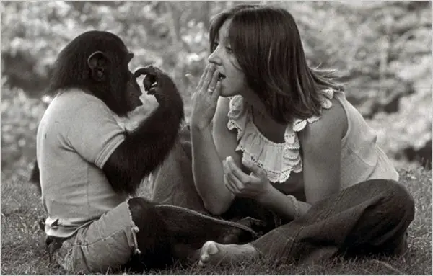
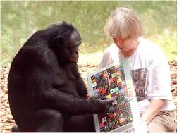
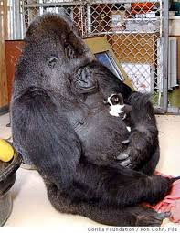

The Evolution of Homo Sapiens and Language
Ape Communication in the Wild
Apes use rich gestures, expressions, and calls
Signals are flexible but rarely symbolic
Communication stays tied to emotion and context
Notes:
Modern great apes give us the closest living window into the communication systems that preceded language.
Chimpanzees, bonobos, and gorillas use dozens of distinct gestures
—reaching, stomping, chest beating, slapping the ground—to express needs and social intentions.
They also combine facial expressions, body posture, and vocalizations to signal play, aggression, reassurance, or submission.
These repertoires are learned through interaction, showing a level of flexibility and social awareness
that goes far beyond reflexive signaling.
Ape communication is especially sophisticated in its use of intentional gestures.
A chimp may tap another’s shoulder to request grooming, or raise a hand to demand food.
They monitor the recipient’s attention and repeat or adjust gestures until they get a response,
revealing an understanding that communication requires shared focus.
This ability to tailor signals to an audience is a crucial precursor to language
—it shows that apes, like humans, recognize that messages must be interpreted by another mind.
Still, ape signals remain grounded in the immediate situation.
A call or gesture always refers to something happening now: a desire, an emotion, a social act.
They rarely use one signal to refer to another, or to describe events displaced in time or space.
Even their most complex combinations lack evidence of syntax
—sequences of gestures don’t change meaning based on order or structure.
In short, ape communication shows both how close and how far our species is from our evolutionary cousins.
Apes can communicate intentionally and flexibly, but they do not appear to symbolize
—to treat signals as abstract tokens that stand for something else.
Their communication shows the roots of social meaning and shared attention,
but not yet the leap into words and grammar.
That leap, as we’ll see next, was tested directly when humans tried to teach apes our own languages.

Slide 11
The Evolution of Homo Sapiens and Language
Impressive Linguistic Accomplishments of Nonhuman Apes
Teaching Apes Human Language Systems
Researchers have tried to teach apes human-like languages
Famous cases show both breakthroughs and limits
These studies reveal how close apes can come to words
Example | Explanation
Learned hundreds of signs or symbols | Apes like Washoe, Koko, and Kanzi acquired vocabularies of 100–400+ symbols, used appropriately in context.
Understood spoken commands | Kanzi followed novel English sentences like “Put the soap in the water,” showing real comprehension.
Combined symbols creatively | Kanzi coined new phrases such as “slow lettuce” for kale, and “wet fruit” for watermelon, indicating flexible use of known terms.
Used gestures intentionally | Apes adjusted gestures based on audience attention—showing awareness of others’ perspectives.
Shared learned signals socially | Washoe and other chimps taught some signs to peers, hinting at rudimentary cultural transmission.
Notes:
For decades, scientists have tried to discover whether language depends on something uniquely human
or whether apes might acquire it under the right conditions.
Early efforts focused on speech but failed—apes’ vocal anatomy cannot produce the range of human sounds.
So researchers turned to other modalities,
teaching sign language and visual symbol systems to see how far their understanding could go.
The first breakthrough came with Washoe, a chimpanzee raised by Allen and Beatrice Gardner in the 1960s.
Washoe learned over a hundred American Sign Language signs
and combined them into short expressions such as “You me go out” or “Gimme sweet.”
She used signs spontaneously and even taught a few to other chimps, hinting at cultural learning.
Washoe’s achievements challenged the assumption that language was an all-or-nothing human trait.
A decade later, Nim Chimpsky, raised in a human environment by Herbert Terrace,
became the subject of a more systematic experiment.
Nim learned hundreds of signs and could produce short sequences like “Eat drink” or “Nim play.”
But when Terrace analyzed his output, he concluded that Nim’s combinations lacked grammar and originality.
Most sequences were imitations of trainers’ signs, not self-generated sentences.
The project ended with a famous paper arguing that Nim was communicating,
but not using language in the human sense.
Meanwhile, Koko the gorilla became a cultural icon under Penny Patterson’s care.
Koko reportedly learned more than a thousand signs and seemed to express emotions
such as sadness, affection, and humor.
She once signed “finger bracelet” for ring and “cry” when her kitten died, deeply moving the public.
Critics, however, noted that her signs were inconsistent
and that her trainers’ interpretations often exceeded what the data supported.
Finally came Kanzi, a bonobo taught by Sue Savage-Rumbaugh in the 1980s.
Unlike earlier subjects, Kanzi wasn’t drilled—he learned naturally by watching his mother’s lessons.
He mastered hundreds of lexigrams (visual symbols) and understood spoken English commands
like “Put the soap in the water” or “Give the dog a hug.”
Kanzi could combine known symbols to make creative utterances such as “slow lettuce” for kale or
“apple chase” when running away with another ape’s apple.
Taken together, these studies show that apes can learn symbols,
use them intentionally, and even combine them in limited ways.
They demonstrate impressive cognitive and social understanding, far beyond mere conditioning.
Yet their communication remains bounded—short, concrete, and heavily dependent on human guidance.
The successes of Washoe, Nim, Koko, and Kanzi blur the line between communication and language,
but they also make that boundary visible: apes can learn the edges of our system, but they cannot cross fully into it.

Slide 12
The Evolution of Homo Sapiens and Language
Linguistic Limitations of Nonhuman Apes
The Limits of Ape Language Learning
Apes share many foundations for language
Primate simulation expanded representation and flexibility
These same abilities may have evolved into symbolic thought
Example | Explanation
Very short utterances | Most productions were one or two symbols long, rarely forming complex sentences.
No consistent grammar or syntax | Word order didn’t affect meaning; combinations lacked structured relationships.
Mostly instrumental use | Communication focused on requests (“Give banana”) rather than declarative sharing.
Limited generativity | New utterances were rare—apes reused familiar phrases instead of creating new ones.
Plateau in vocabulary size | Progress slowed around the level of a human toddler; no explosion of new word learning.
Dependent on human training | Skills required intensive teaching and rarely emerged spontaneously in social groups.
Notes:
The ape language studies showed that our cousins possess much of the groundwork for language
—attention sharing, imitation, and intentional communication.
They can learn symbols and understand others’ goals, but their messages remain short, concrete, and bound to the present.
What seems to be missing is not intelligence, but a certain kind of representational flexibility
—the ability to treat ideas as stand-ins that can be freely swapped and recombined.
That flexibility may have originated in the primate capacity for mental simulation.
As we discussed last week, primate brains are powerful simulators.
They can imagine actions before performing them and model the likely responses of others.
Doing this requires treating the “self” and “other” as interchangeable within an internal scene:
a kind of role substitution that already resembles using variables in a symbolic system.
In other words, primates can manipulate models of minds and behaviors,
but humans extended that trick to manipulate symbols themselves.
Once a brain could swap self and other, it could also substitute present and future, real and imagined.
That opened the door to narrative thought—replaying past events, planning future ones,
and embedding these imagined selves into shared social stories.
The mental grammar of simulation may have been the scaffolding on which linguistic grammar later formed.
Language then externalized those inner role-swapping structures, turning private imagination into public communication.
So the difference between apes and humans may not be the sudden invention of symbols from nothing.
It may lie in the amplification of a preexisting ability to simulate, substitute,
and generalize across roles and times.
Once that flexible representational system combined with shared attention and teaching,
the path toward symbolic language was open.
Human speech may therefore be the audible form of a deeper cognitive leap:
a mind that could already imagine itself—and others—in multiple versions and times.

Slide 13
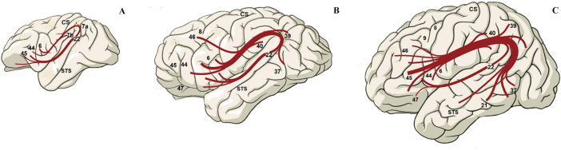
The Evolution of Homo Sapiens and Language
From Simulation to Symbolic Thought
Primate minds simulate self and others
Flexible representations became symbolic variables
These abilities paved the way for language
Notes:
In the last module we saw that primates differ from other mammals in their ability to simulate
—to imagine actions, outcomes, and even the inner states of others.
They can mentally rehearse a behavior before doing it, or predict what a rival might do next.
This capacity for inner modeling is what makes primate social life so strategic,
but it also laid the cognitive groundwork for language.
It introduced minds that could represent reality, not just react to it.
To simulate another’s behavior, a primate must temporarily substitute that individual for itself in the mental model
—an act of representational flexibility.
It must treat “self” and “other” as interchangeable roles within the same internal schema.
That swapping ability is a small but crucial step toward symbolic representation:
a system in which tokens stand for things that are not themselves.
Once the mind could swap variables inside its own simulations,
it wasn’t a huge leap to swap sounds or gestures for those same internal roles.
This flexibility also opened the door to thinking across time.
If the self can be replaced with the past self, or an imagined future one,
then the simulation can represent “what I did yesterday” or “what I will do tomorrow.”
That temporal displacement mirrors what language later achieves through tense and narrative
—the grammar of imagination already forming in the mind’s theater.
Language, in this sense, may have evolved as an externalization of these inner variable-based models.
So when we ask what makes human communication different, it may not be just the invention of words and syntax.
It could be the refinement of a mental architecture that was already symbolic in spirit
—a brain that could represent roles, swap elements, and project them across contexts.
The labels and grammar of language might simply be the public expression of a capacity that began as silent simulation.
This continuity helps explain why language feels natural to us:
it is built from the same mental machinery we already use to imagine, empathize, and plan.

Slide 14
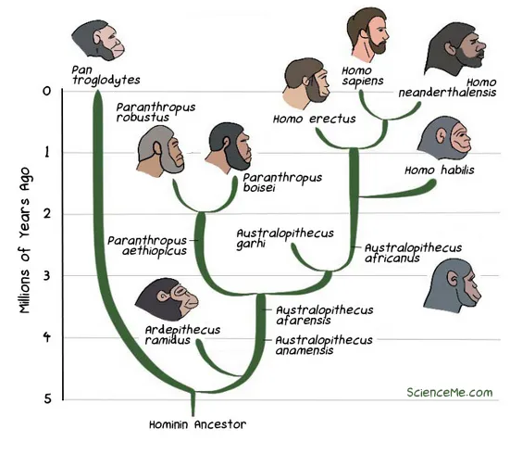
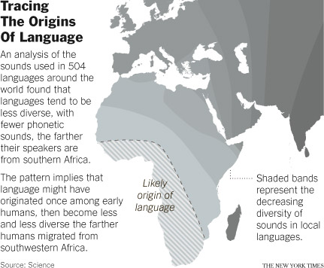
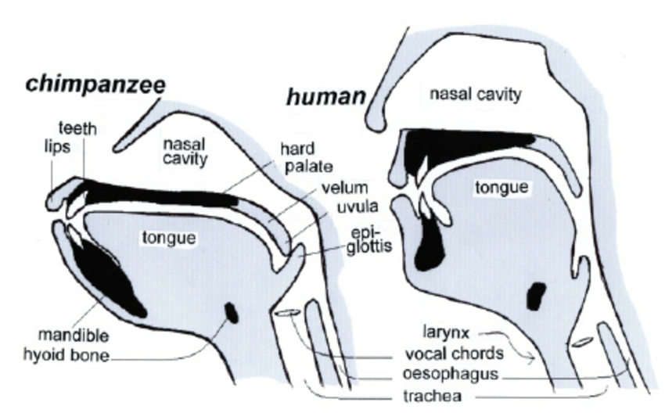
The Evolution of Homo Sapiens and Language
When and Where Did Language Emerge?
Fossil and archaeological clues are indirect
Where: Africa. When?
Estimates range from early Homo to modern humans
Language likely evolved gradually, not suddenly
Notes:
We’ve now sketched out what language is,
and how human language differs from other forms of communication.
Next come the evolutionary questions:
When, how, and why did language evolve?
Let’s begin with where and when.
Pinpointing the origin of language is one of the hardest problems in science.
Words and grammar leave no fossils, and the soft tissues needed for speech don’t preserve.
All we have are indirect clues—from skulls, tools, artifacts, and the genes and brains of their descendants.
Even so, these clues allow us to sketch a plausible story of where and when language took shape.
Some researchers place its beginnings deep in our lineage,
with Homo erectus, nearly two million years ago.
They point to larger brains, cooperative hunting, and long childhoods
as evidence that complex communication was already emerging in Africa.
Others argue for a much later origin, around 100–200 thousand years ago,
when Homo sapiens developed symbolic art, ornaments, and ritual behavior.
Still others see multiple stages—gesture, proto-speech,
and full syntax unfolding gradually across species and continents.
Anatomical evidence gives a few anchor points.
The position of the larynx and the size of the hypoglossal canal
suggest that by at least 400,000 years ago,
our ancestors could control breath and articulation much like we do.
Meanwhile, genetic evidence—especially changes in the FOXP2 gene—
shows that neural circuits for vocal learning were evolving before modern humans appeared.
Taken together, these signs point to a long, gradual transition rather than a single invention.
Language likely emerged through cumulative refinement
—a process of biological and cultural feedback.
Early gestures and vocal calls expanded into proto-language,
and later into speech systems rich enough for teaching, storytelling, and shared imagination.
By the time of Homo sapiens, language was fully integrated into social life,
shaping the minds that shaped it in return.
Next, we’ll turn to the question of why that new system was so adaptive once it arrived.

Slide 15
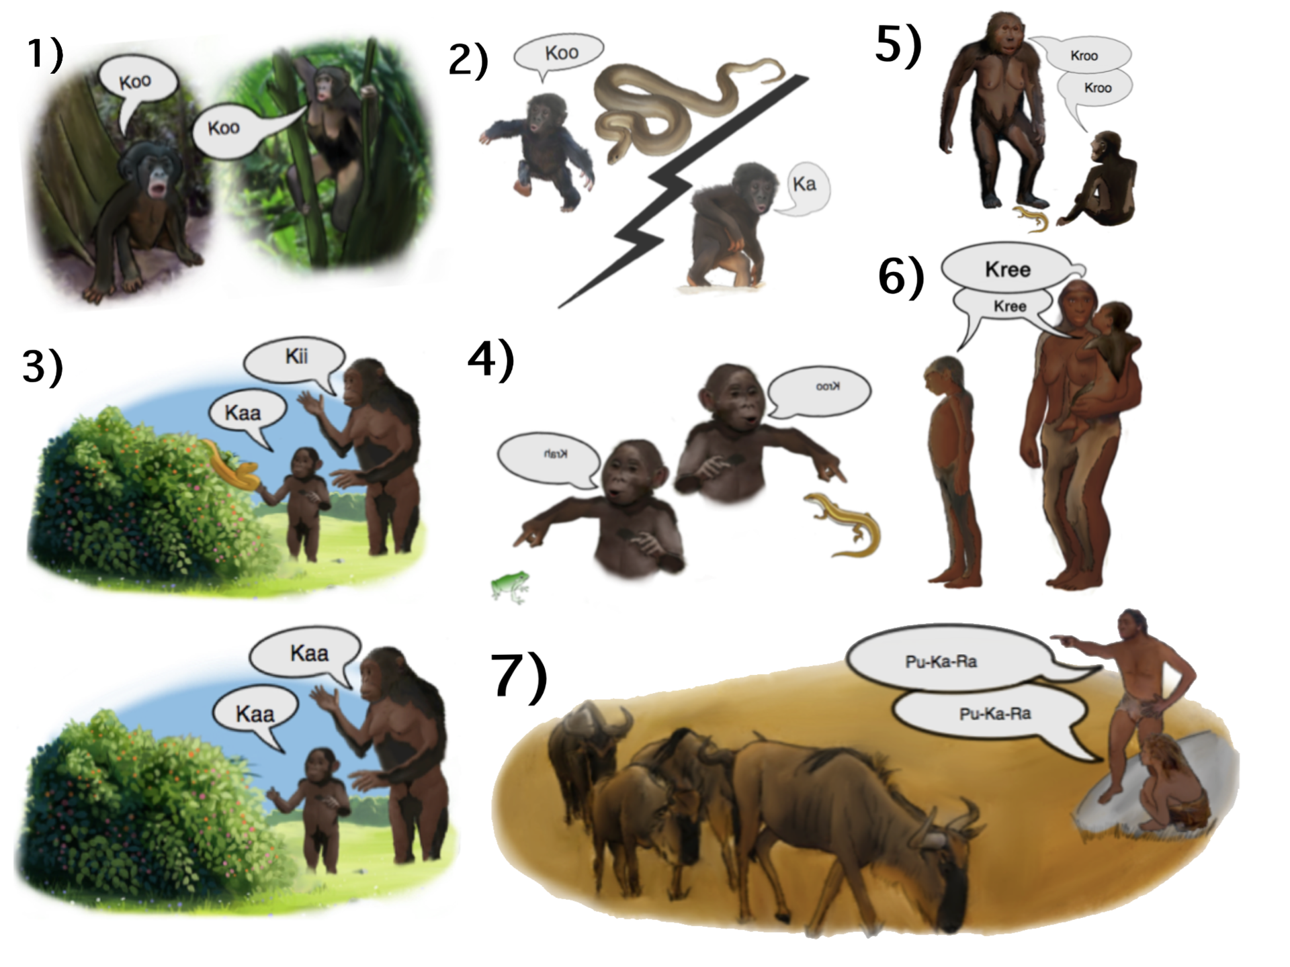
The Evolution of Homo Sapiens and Language
How Did Language Evolve?
Language’s origins remain debated and uncertain
Different hypotheses emphasize different selective pressures
The truth may combine several interacting causes
Notes:
Even after decades of study, there is no single agreed-upon story for how language emerged.
Fossil and archaeological evidence are indirect, and speech itself leaves no trace.
Researchers instead look to the capacities that must have come together—
motor control, social learning, vocal imitation, and symbolic thought.
Each hypothesis highlights a different pathway by which those ingredients may have converged.
One long-standing view is the gesture-first hypothesis.
It proposes that early humans relied on hand signs and facial expressions long before vocal speech.
Gestures are visible, flexible, and still woven into conversation today,
suggesting that language began as a visual-motor system before shifting to sound.
Overlap between brain regions for manual action and speech supports this continuity.
Another account sees language as an exaptation—a by-product of expanding intelligence.
In this view, internal representational systems evolved first, allowing structured thought and planning.
Speech then arose as a way to externalize these mental hierarchies for teaching and coordination.
This perspective, often linked to Chomsky,
treats language as a cognitive architecture that predated its communicative use.
A third proposal emphasizes vocal learning and neural coevolution.
As breath control, fine motor timing, and auditory feedback improved,
early hominins may have gradually shaped their vocalizations into structured signals.
This process could have piggybacked on musical or emotional expression—
systems already tuned for rhythm, imitation, and shared affect.
Finally, cultural evolution may have been the key driver tying these elements together.
Once a rudimentary communication system appeared, social learning could refine and elaborate it.
Words, conventions, and grammar would accumulate across generations,
gradually reshaping both behavior and brain through feedback.
In this view, language was not a single adaptation but a complex self-organizing process—
a coevolution of gesture, voice, thought, and culture.

Slide 16
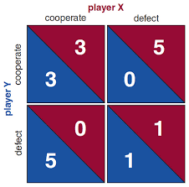
The Evolution of Homo Sapiens and Language
Why Did Language Evolve?
Language is costly and complex
It benefits others as much as oneself
So why did it persist and spread?
Notes:
Now, why did language evolve?
From an evolutionary perspective, language is a mystery.
It takes large brains, long learning periods, and constant use,
yet it often helps the listener more than the speaker.
When one person warns of danger, shares food locations, or teaches a skill, everyone else gains information at little cost.
In theory, selfish individuals could simply listen without contributing
—so why didn’t such free riders make language collapse?
This puzzle is sometimes called the paradox of language:
How could a system based on cooperation survive natural selection,
which usually rewards individual advantage?
If communication were purely self-serving, we’d expect signals to be manipulative or deceptive,
not truthful and prosocial as human language often is.
Something about our social or cognitive environment must have made honesty, sharing,
and teaching worth the effort.
Understanding why language evolved means identifying what kinds of pressures made talking adaptive.
Was it to maintain social bonds? To share knowledge?
To attract allies or mates?
Each of these possibilities implies a different pathway by which words became woven into human survival.
The next few slides will explore these competing hypotheses
and the mechanisms that may have stabilized cooperative communication.

Slide 17

The Evolution of Homo Sapiens and Language
Adaptive Payoffs of Language
Information sharing, teaching and learning
Social cohesion
Planning and coordination with others and oneself
Notes:
The advantages of language were broad and compounding.
It transformed how early humans survived, learned, and lived together.
Talking didn’t just make communication faster—it changed what could be communicated at all.
Once words existed, new kinds of cooperation, learning, and imagination became possible.
Language first enhanced information sharing.
It let individuals describe things not immediately present
—food sources, dangers, and opportunities.
This ability to talk about the unseen made foragers and hunters more efficient
and allowed communities to coordinate across distance and time.
It also revolutionized teaching and learning.
Before words, skills had to be acquired through observation or imitation
—slow, error-prone processes.
Speech allowed explicit instruction: not just showing what to do, but telling how and why.
This made cultural knowledge easier to preserve and refine from one generation to the next.
Language supported new forms of planning and coordination.
Groups could share intentions, divide labor, and evaluate past successes or failures.
They could plan actions that depended on mutual understanding
—“You take that side,” “Wait until nightfall.”
Such cooperative foresight was a major leap beyond instinctive signaling.
Finally, language reinforced social cohesion.
By sharing stories, explanations, and emotions, humans built a shared sense of identity and purpose.
They could articulate norms, repair misunderstandings, and imagine collective futures.
Talking together turned scattered individuals into stable, goal-directed communities.
In all these ways, language multiplied the power of cooperation.
It made knowledge cumulative, coordination flexible, and social life resilient.
Whatever sparked its origin, once language appeared, the advantages of keeping it spread rapidly.

Slide 18
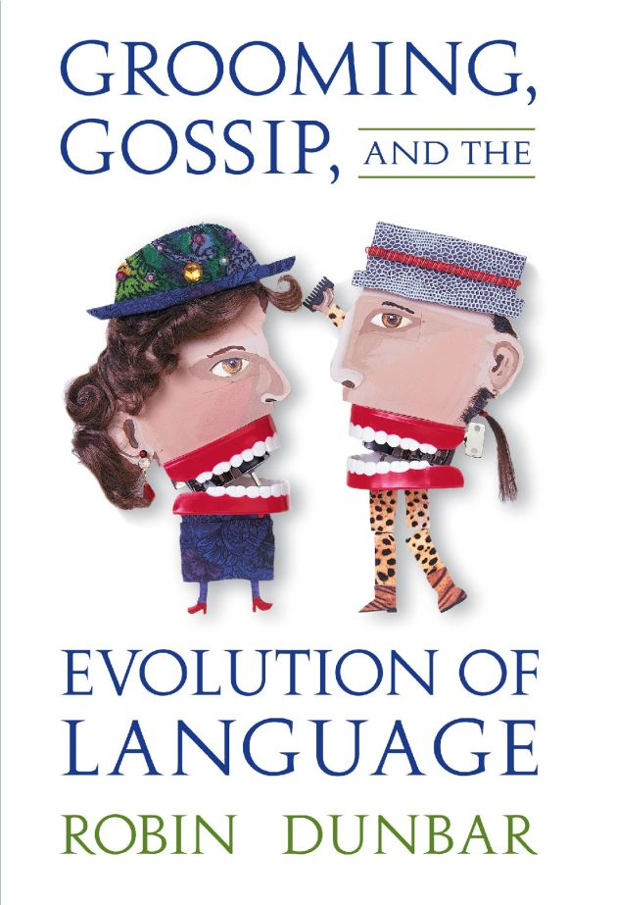
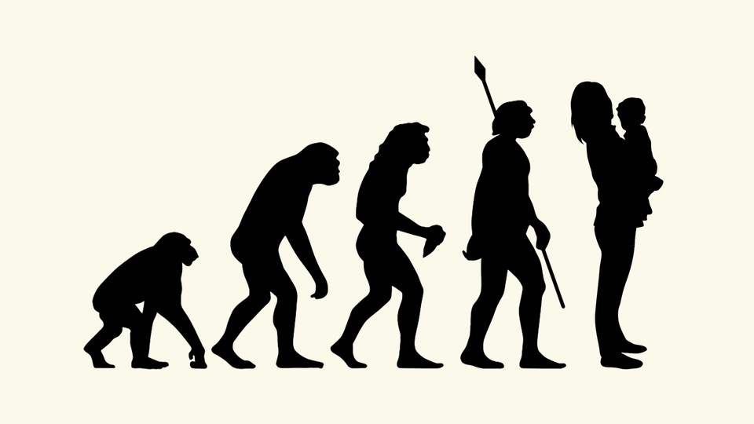
The Evolution of Homo Sapiens and Language
Language as a Social Lubricant
Language first spread through close relationships
Talking built trust, comfort, and attraction
Speech became a social and emotional bond
Notes:
Before it became a tool for coordinating large groups,
language may have begun in the most intimate of settings.
Some researchers propose that the earliest conversations occurred between mothers and children
—vocal reassurance, soothing, and teaching.
“Motherese,” or infant-directed speech, encourages attention and imitation;
it may be a living remnant of those early exchanges.
Language in this sense began not as a system of planning,
but as an emotional technology for connection.
Once communication became rewarding in its own right, it spread beyond kin.
Speech offered new ways to build friendships,
strengthen pair bonds, and reduce tension within groups.
Simple exchanges of attention or sympathy
—“Are you okay?” “That was scary.” “I like you.”
—would have had enormous emotional value.
Through words, affection and reassurance became as tangible as touch.
Gossip may have grown from this base.
As social networks expanded, people began using language to talk about relationships
—to share stories, express loyalty, or warn of betrayal.
Speech became a way to navigate the social landscape of who liked whom, who helped, and who deceived.
This exchange of social information shaped reputation and trust, giving talkers influence in their communities.
Over time, language became woven into every form of human relationship
—friendship, rivalry, kinship, mentorship, and romance.
Fluent communication signaled empathy, intelligence,
and emotional awareness, qualities attractive to both allies and mates.
From lullabies to love songs, talk comforted, connected, and persuaded.
Before language built societies, it built relationships—and that may be what made it evolutionarily irresistible.

Slide 19
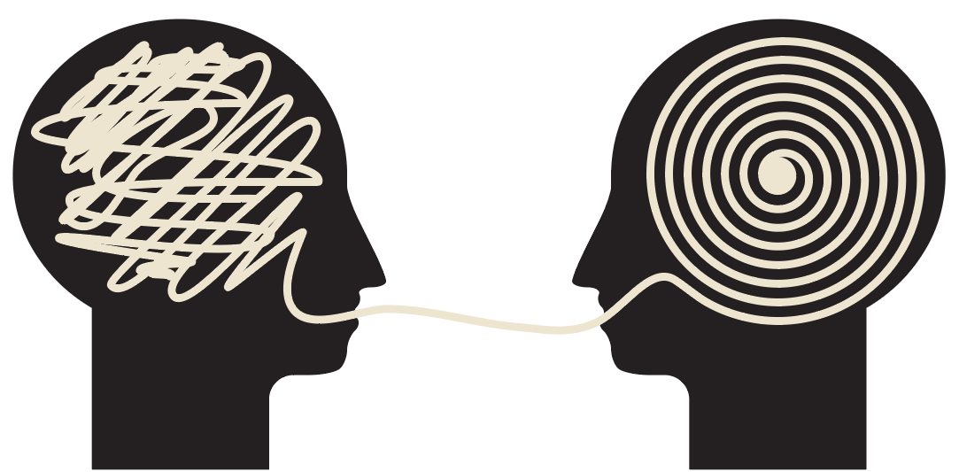
The Evolution of Homo Sapiens and Language
Language for Thought
Language may have begun as inner speech
Words help structure symbolic imagination
Talking to ourselves made thinking more powerful
Notes:
Not all theories see language as evolving primarily for communication or social benefit.
Some argue that it began as a tool for thinking,
an internal technology for organizing memory, planning, and self-control.
This view suggests that early humans learned to name their own experiences
before they learned to share them, turning words into handles for thoughts.
Speech may have been externalized later,
once those internal structures proved useful for teaching and coordination.
Language gives the mind a way to symbolize its own simulations.
Instead of rehearsing whole sensory scenes, people can use words as shortcuts—“fire,” “tool,” “danger.”
This compression makes complex ideas easier to store, manipulate, and compare.
Words allow abstract reasoning, analogy, and logical inference, expanding the reach of imagination far beyond immediate perception.
Inner speech also enhances cognitive control.
By talking to themselves, early humans could rehearse actions, weigh choices, and suppress impulses.
Language becomes a way to guide attention and regulate behavior: “Don’t run,” “Wait,” “Try again.”
This self-directed communication links verbal ability to executive function, a hallmark of modern human intelligence.
In this view, language evolved not only to share ideas but to create them.
It turned fleeting sensory experience into stable, manipulable symbols that could be combined and reexamined.
Human thought became recursive, self-aware, and flexible—capable of simulating not just what is, but what could be.
Language, in this sense, is both the mirror and the engine of the human mind.

Slide 20
The Evolution of Homo Sapiens and Language
 | REINFORCING IN EARLY BILATERIANS | SIMULATING IN EARLY VERTEBRATES | MENTALIZING IN EARLY PRIMATES | SPEAKING IN EARLY HUMANS
SOURCE OF LEARNING | Learning from your own actual actions | Learning from your own imagined actions | Learning from others' actual actions | Learning from others' imagined actions
WHO LEARNING FROM? | Yourself | Yourself | Others | Others
ACTION KIND? | Actual actions | Imagined actions | Actual actions | Imagined actions
Cumulative Culture
Language made knowledge cumulative
Ideas began evolving faster than genes
Culture became a new kind of inheritance
Notes:
Language didn’t just change how humans communicated—it changed what could evolve.
Once speech emerged, ideas began to accumulate, refine, and spread.
Communication stopped being only about immediate coordination;
it became a way to preserve, improve, and transmit knowledge across time.
Through words, teaching, and storytelling, experience no longer vanished with the individual.
Each generation could inherit the insights of the last and add their own refinements.
A new evolutionary process began—not in genes, but in information itself:
the evolution of ideas within culture.
Precise verbal instruction meant that useful discoveries no longer had to be reinvented.
A toolmaking technique, a foraging trick, or a social rule could spread through imitation,
be improved by others, and passed down intact.
Language compressed complex experiences into teachable formulas—
“Sharpen the edge first,” “Wait until the fire dies down,” “Hide until the sun is low.”
What once took months of trial and error could now be learned in minutes.
Over generations, this efficiency produced cumulative culture—
the gradual buildup of technologies, norms, and shared understanding.
Fire-making, clothing, and coordinated hunting were not individual inventions
but collective ones, shaped by countless contributors.
Human societies came to possess more knowledge than any single mind could hold—
a form of distributed intelligence built on shared language.
At this point, learning itself became a collective property of the species.
Language turned communication into memory and memory into progress.
It allowed human knowledge to evolve through variation, selection, and transmission,
creating a second, faster layer of evolution alongside biology.
From here, culture would begin to feed back on cognition and society in ever-accelerating ways.

Slide 21
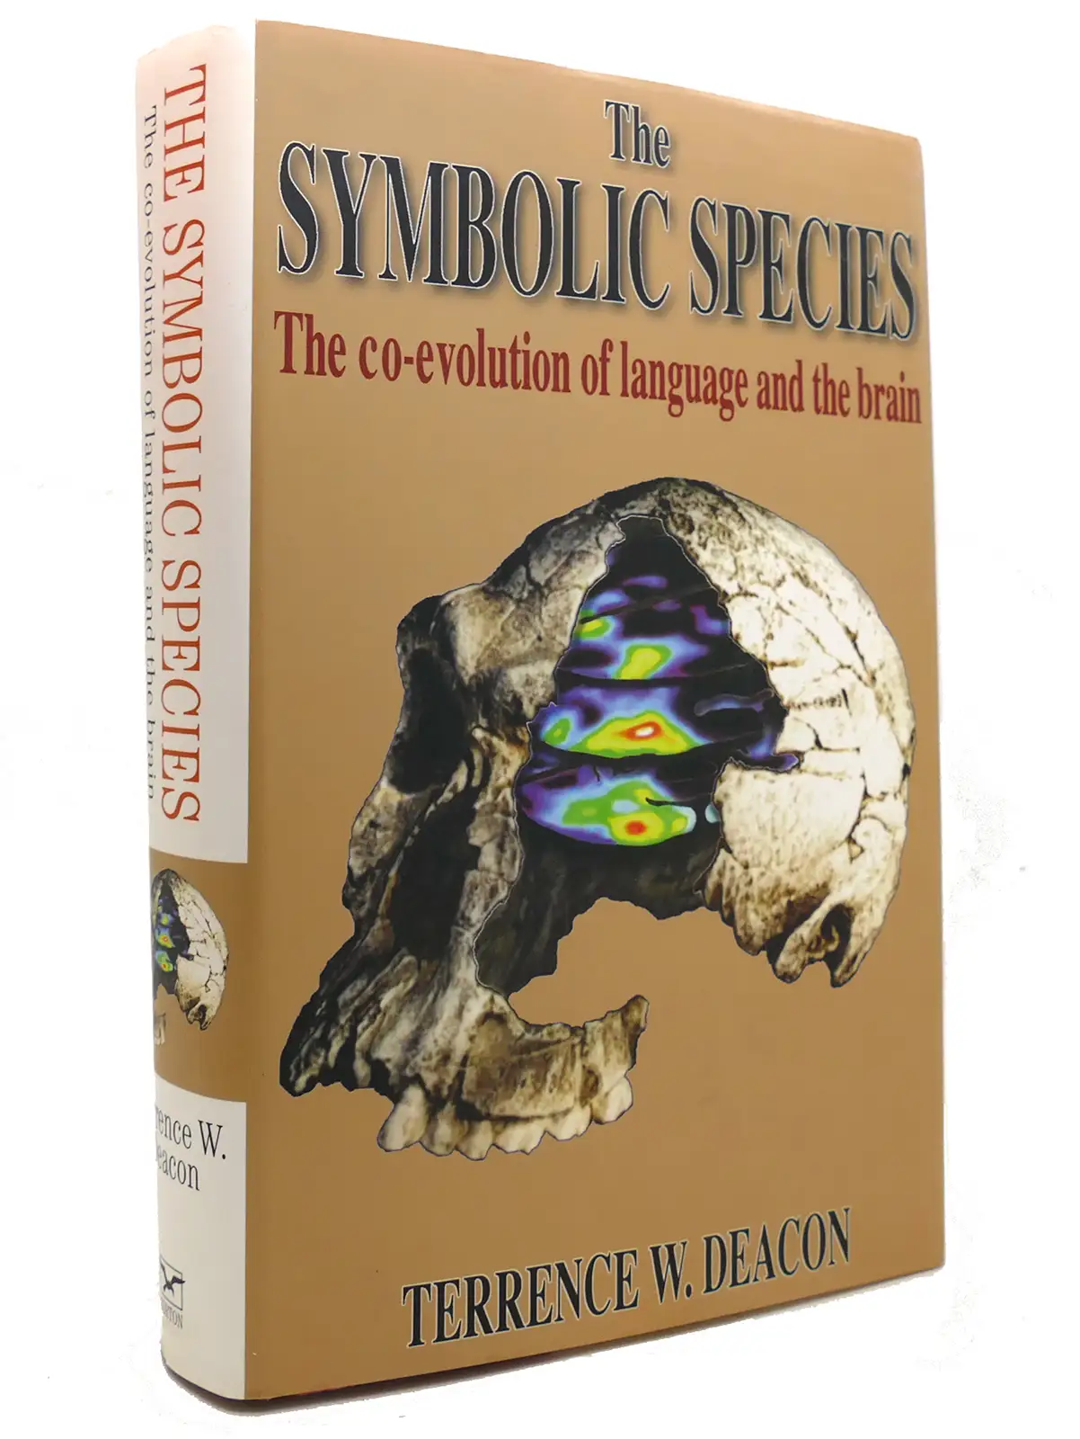
The Evolution of Homo Sapiens and Language
The Runaway Feedback Loop
Language, cooperation, and brain growth reinforced each other
Bigger groups required better communication
Better communication supported even larger groups
Language
Cooperation & Culture
Energy & Brain Growth
Notes:
Once language began to reshape social life, its effects compounded.
Groups that communicated more effectively coordinated hunts,
shared food, and taught skills more efficiently.
These advantages favored the evolution of larger social networks,
which in turn demanded even greater communicative sophistication.
A feedback loop emerged: language enabled cooperation,
cooperation selected for communication, and both drove brain expansion.
As hominin societies grew, individuals had to track more relationships and more layers of reputation.
Managing this complexity required memory, inference, and attention
—capabilities supported by an expanding neocortex.
Neuroanatomical studies suggest that species with larger group sizes
tend to have larger neocortices, and humans sit far above the trend line.
The demands of language and social reasoning likely fueled this neural growth,
producing brains capable of managing hundreds of social connections.
Cultural complexity grew in parallel.
Language allowed not just the sharing of information but the construction of shared worlds
—myths, norms, and joint goals that bound groups together.
These collective narratives created stable identities and transmitted moral codes,
allowing cooperation among strangers.
The ability to imagine and agree on symbolic fictions
—tribes, totems, deities, nations—became a decisive evolutionary advantage.
Over time, this loop between communication, cooperation,
and cognition produced what anthropologist Terrence Deacon called “the symbolic species.”
Each improvement in language supported richer culture,
and each cultural advance rewarded those who could learn and teach more effectively.
In this way, natural selection began to act not just on individuals,
but on communities and the shared knowledge that sustained them.
Language was both the spark and the engine of this runaway process
—the catalyst that transformed a clever primate into a civilization-building species.

Slide 22
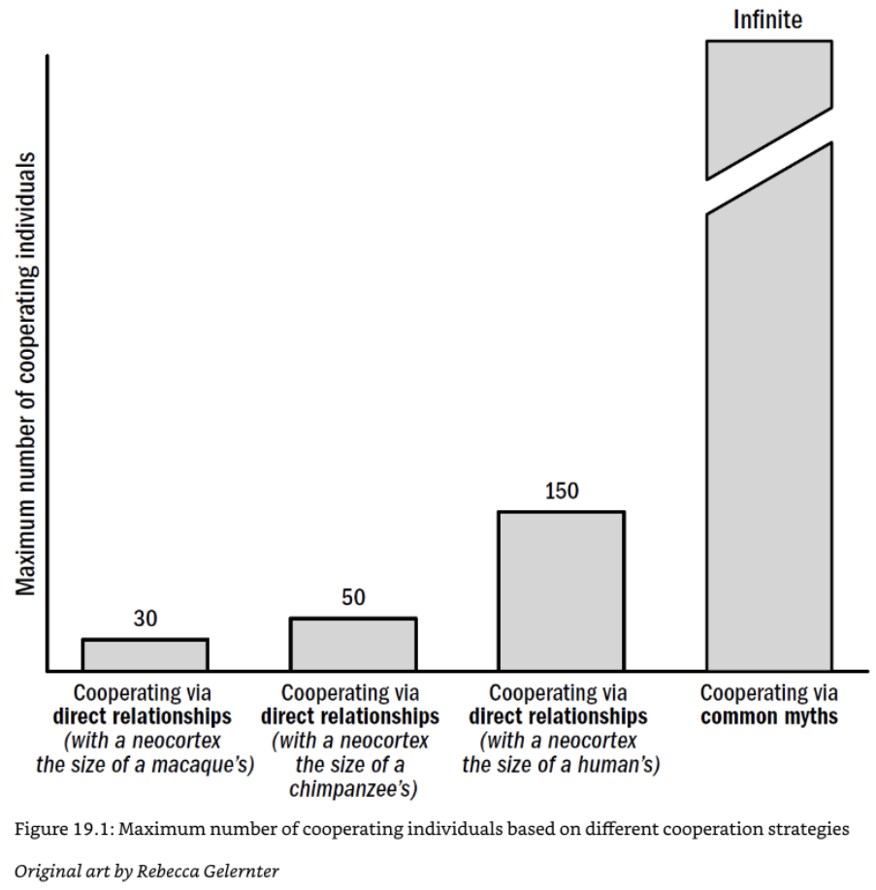
The Evolution of Homo Sapiens and Language
From Language to Symbolic Culture
Language enabled shared imagination and abstract ideas
Symbols allowed cooperation beyond direct experience
Culture became a network of shared meanings
Notes:
Once language matured, it did more than convey information
—it created shared worlds of meaning.
Words let people refer not only to physical objects but to invisible entities:
spirits, kinship, justice, time, and truth.
Through stories and explanations, humans began to construct collective realities
that existed only because everyone believed in them.
These symbolic worlds became the scaffolding of culture.
Symbols allowed humans to cooperate in ways no other species could.
People could coordinate around abstract concepts—families, clans, and gods
—without direct sensory evidence.
They could imagine obligations and identities that stretched across time and distance,
uniting strangers under common ideals.
Language thus turned social groups into symbolic communities bound by shared narratives.
As these shared systems grew more intricate,
they generated institutions and traditions that no individual could invent alone.
Myths, rituals, laws, and moral codes became the cognitive infrastructure of societies.
Through them, people transmitted values, stored collective memory,
and preserved specialized knowledge across generations.
Cultural symbols became tools for thinking as much as for belonging.
This transformation marked the threshold from language to symbolic cognition, which we’ll explore next week.
Once minds could use external symbols to represent internal states,
they began building complex systems of logic, art, mathematics, and religion.
Language was the seed; symbolic culture was the forest that grew from it.
Through words, humans didn’t just describe the world—they began to create new ones together.

Slide 23
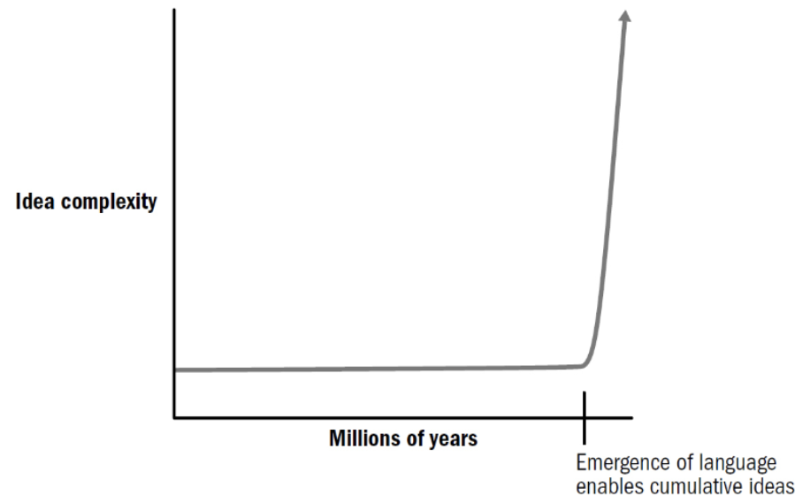
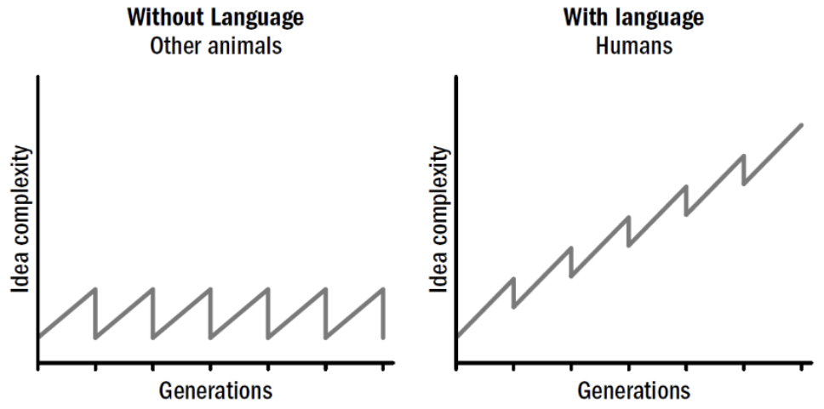
The Evolution of Homo Sapiens and Language
The Singularity Has Already Happened
The “singularity” usually means future machine intelligence
Intelligence and idea starts growing exponentially
But arguably it has already happened—with language and culture
Notes:
You sometimes hear people talking about the approaching singularity.
When people talk about the singularity, they usually mean a hypothetical future
in which artificial intelligence surpasses human ability and begins improving itself at accelerating speed.
But from another perspective, something very much like that has already occurred—within our own species.
The invention of language and cumulative culture created a self-amplifying system of intelligence, l
ong before computers existed.
Through communication, teaching, and shared knowledge,
human minds became nodes in a collective network that evolves ideas faster than genes evolve bodies.
Before language, learning was limited by the lifespan and memory of individuals.
After language, information began to reproduce independently,
spreading from person to person, generation to generation.
Each innovation built on the last, producing an accelerating curve of cultural complexity
—tools, technology, art, and science emerging in quick succession.
From this angle, the “cultural singularity” happened tens of thousands of years ago,
when information itself began to evolve through language.
This perspective reframes what it means to be intelligent.
The human brain didn’t just grow bigger—it linked into a collective network
that continually refines its own knowledge.
We already live inside a distributed cognitive system that learns, remembers,
and adapts far faster than any individual mind.
The story of language, then, is not only about how humans began to speak
—but about how the universe itself began to think in a new way.

Slide 24
The Evolution of Homo Sapiens and Language
Summary
Language transformed communication and cooperation
It built on primate social and cognitive foundations
Next Time
How language actually works in the mind
Notes:
Language was not a sudden invention but the culmination of many evolutionary threads.
It built on the communication systems of mammals and primates,
extending them through imitation, teaching, and shared imagination.
Gestures, vocal calls, and social cognition provided the raw materials;
mental simulation and flexible representation turned them into something new.
Through these combined abilities, language emerged as an adaptation for exchanging ideas rather than just signals.
Once words and grammar appeared, they created a feedback loop of cultural and cognitive growth.
Language made cooperation scalable, learning cumulative, and culture self-perpetuating.
It allowed humans to teach, plan, and invent collectively,
transforming intelligence from an individual property into a social one.
Every major step in human history—tools, art, myth, science
—flows from this capacity to share internal models of the world.
This week’s first lecture has focused on why language evolved
—what adaptive problems it solved and how it built on earlier capacities.
In the next lecture, we’ll turn to the question of how it works.
We’ll look at competing theories of the language system itself:
the behavioral and learning-based approaches of Skinner and connectionism,
and the rationalist, rule-based theories of Chomsky and symbolic cognition.
The debates that shaped modern cognitive science began with this question—and they’re still unfolding today.

